Slide 1
Introduction

Slide 2
Objectives
A Language for Complex Applications
Object Terminology
Abstraction
Encapsulation
Hierarchy
Polymorphism

Slide 3
A Language for Complex Applications
Many software applications are complex.
The underlying problem domain is often quite intricate and detailed.
For an application to be practical and usable, it must represent some of the complexity of the problem domain.

Slide 4
Complexity
We create a software solution by extracting the most important features of the problem domain.
There are 2 ways to identify the most important features:
into activities (distinct algorithms)
into things (distinct objects)
The two approaches are not mutually exclusive. We start with one approach and use its results as the basis for the other.
This decomposition is an iterative process.

Slide 5
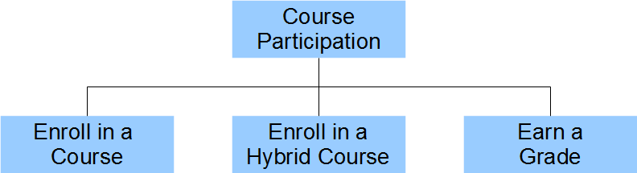
Complexity (Example)
Consider a course enrollment system for a program in a college or university. Each participant
enrolls in several face-to-face courses
enrolls in several hybrid courses
earns a grade in each course
The following structure diagram identifies the activities.

Slide 6
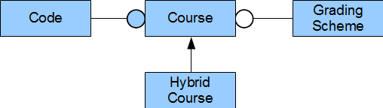
Complexity (Example)
If we switch our attention to the objects involved, we find a Course and a Hybrid Course. Course has a Code and uses a Grading Scheme and that a Hybrid Course is a kind of Course
The emphasis in this diagram is on the objects rather than the functional activities performed on them. The functional activities become part of the description of the objects themselves.

Slide 7
Object Terminology
There are four fundamental concepts
Abstraction
Encapsulation
Hierarchy
Polymorphism

Slide 8
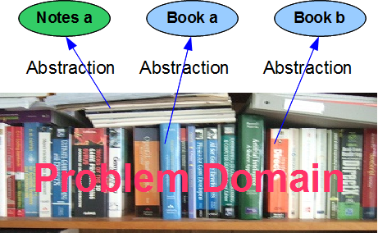
Abstraction
Abstraction reduces the complexity of a problem domain.
Each object is an abstraction of one important aspect of the problem domain.
The objects that make up the solution ignore the non-essential features of the problem.

Slide 9
Abstraction
Each object has a crisp boundary that distinguishes the object from all other objects.
Each object has integrity: it can only behave in ways that are appropriate to itself.
Ex
An ear cannot see, an eye cannot listen and a mouth cannot smell.
A horse cannot bark and a dog cannot croak.

Slide 10
Abstraction
An application may contain many objects.
Objects that have similar features and respond in a similar manner may share a common structure.
A description of this common structure is called a class. A class describes the structure of the data held by an object and the behavior of the object.

Slide 11
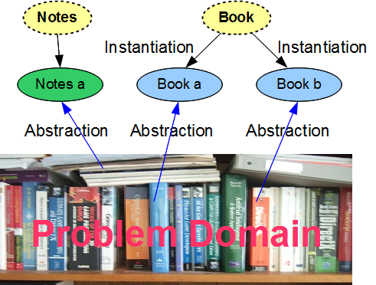
Abstraction – Classes & Objects
An object may have values that distinguish it from another object in a class.
The values stored in each object may vary from object to object, but the set of variables and their data types are common.
Each object is an instance of the class. The terms object and instance are interchangeable.

Slide 12
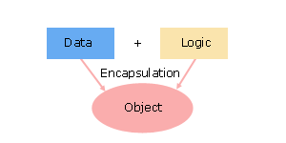
Encapsulation
Encapsulation separates the implementation details of an object from its external appearance.
Encapsulation focuses on the interior of an object, combining the data that describes the object's state and the algorithms that define its behavior.

Slide 13
Encapsulation
class Student
char enroll[10];
char name[38];
double gpa;
void setEnroll(char cER[]);
public:
void setName(char cName[]);
void setGpa(double dGpa);
char[] getEnroll();
char[] getName();
double getGpac();
…
A well-encapsulated object has all of its implementation details hidden within the object.
If an object is well-encapsulated, a developer can change the object's internal structure without introducing any changes to the software that uses the object.

Slide 14

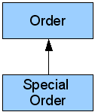
Hierarchy
Some of the objects in an application may be hierarchically related to one another. The hierarchy may be one of:
aggregation, or
shared structure and behavior
Aggregation describes a "has a" relationship between objects. The parent object "has a" child object. The two objects need not share a common structure.
Shared structure and behavior entails an "is a kind of" relationship. This appears as a hierarchy of classes. One class "is a kind of" another class

Slide 15
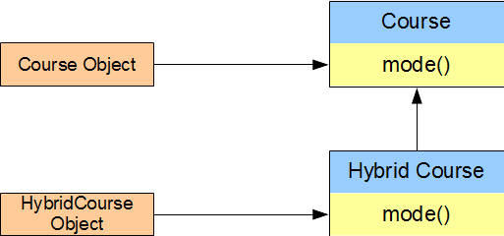
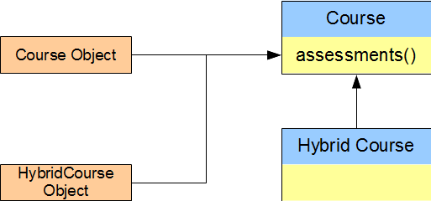
Polymorphism
Polymorphism relates the implementation for an object based on its type
The HybridCourse object involves a different mode of delivery than the Course object, but the same assessments. Both objects belong to the same hierarchy: both are Course objects.
A mode() query on a Course type reports a different result than a mode() query on a Hybrid Course type.

Slide 16
Summary
Objects are abstractions of the most important chunks of information from a problem domain. They distinguish the different feature sets in the problem domain.
A class describes the structure common to a set of similar objects. Each object in the set is a single instance of its class.
Encapsulation hides the implementation details within a class - the internal data and internal logic are invisible to client applications that use objects of that class.
We can upgrade the structure of a well-encapsulated class without altering any client code.
The cornerstones of object-oriented programming are encapsulation, inheritance and polymorphism.
Notes:
Cornerstones: nền tảng

